Slide 1
Data Visualization with Gnuplot
Can Ay
Sang-Joon Han
Mohamad Kisanieh
Trong Khang Vu
https://github.com/TKVuBER/pic-wise23-DataVisualization-project

Slide 2
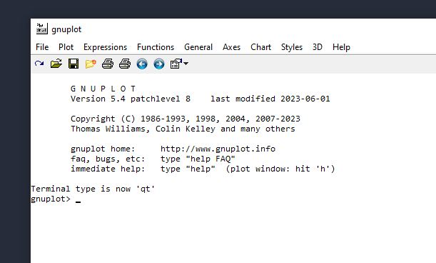
Problem Statement
Develop a data visualization that generates charts, plots, and graphs from input data.
Use of open-source software Gnuplot within a C application (Codeblocks)

Slide 3
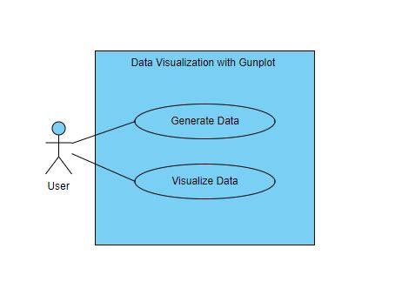
Use Case-Diagram
Generate Data:
User specifies data parameters
Visualize Data:
User request data visualization
System utilizes gnuplot to visualize data

Slide 4
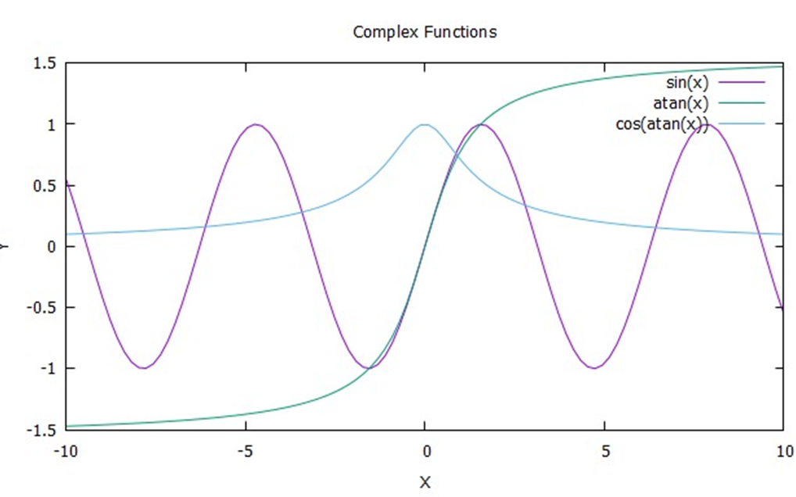
Features and Functionalities
With a modification of the code, the user can display the desired function
Enhanced Understanding
Data Exploration
Detection of Anomalies
Decision-Making Support

Slide 5
Scheduling Table
Task | Responsible Team Member | Deadline
Project Planning | Mohamad Kisanieh | 30.10.2023
Development | Can Ay Sang-Joon Han Mohamad Kisanieh Trong Khang Vu | 07.01.2024
Testing/ Debugging and Refinement | Mohamad Kisanieh Sang-Joon Han | 10.01.2024
Documentation | Trong Khang Vu | 12.01.2024

Slide 6
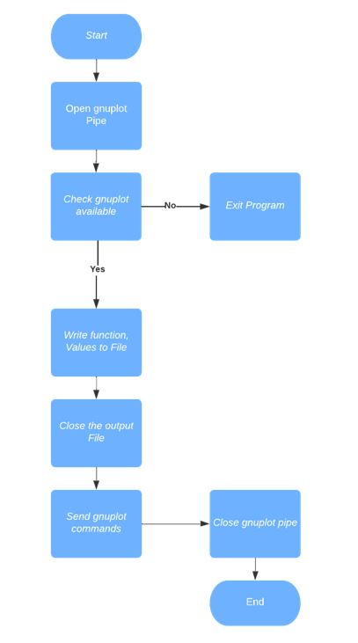
Algorithm Flowchart and Technology Used
Codeblocks 20.03
Gnuplot ver 5.4 patchlevel 8

Slide 7
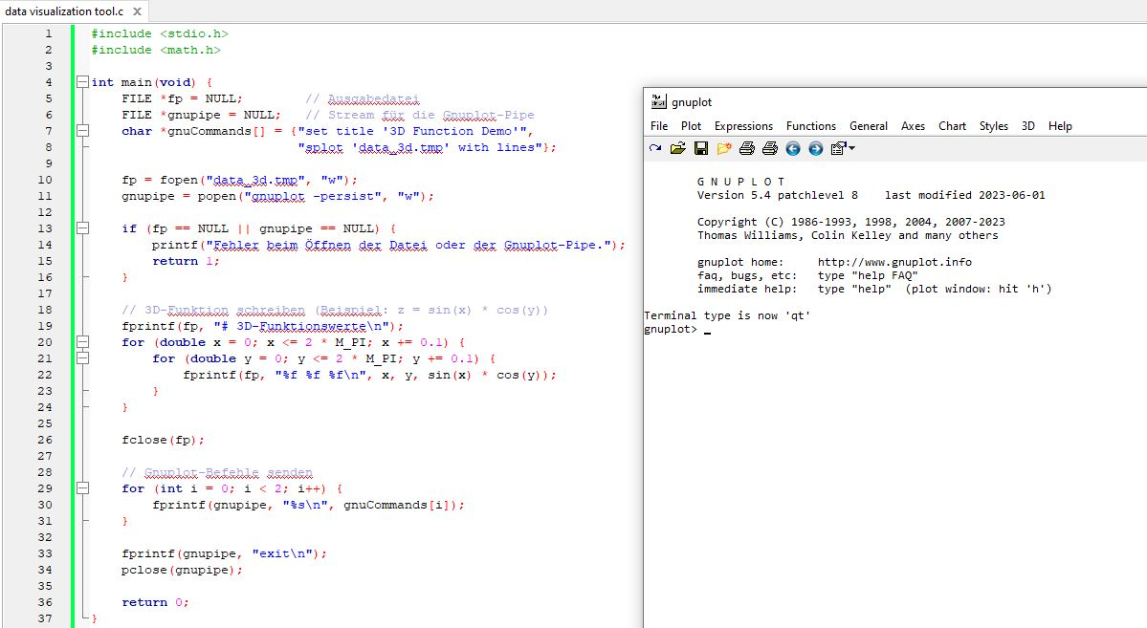
Graphical User Interface (GUI)

Slide 8

Future Development Plan
The next step could be to further develop the program by inputting the functions or function values in a separate file.
The program would then read these values automatically and graphically represent them.
[1]

Slide 9
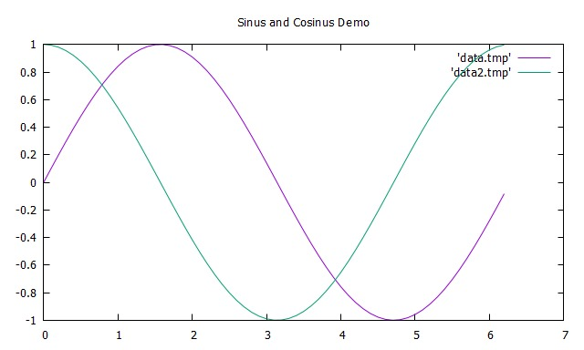
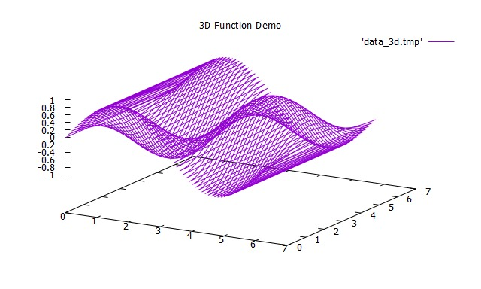
Conclusion
The realization of this project will create a data visualization tool in C, with applications in various fields, including science, education and data analysis. It will also demonstrate the capability of creating charts and graphs in C and showcase the potential of the Gnuplot library.

Slide 10
Thank you for your attention!

Slide 11
Scources
[1] https://pixabay.com/illustrations/question-mark-question-response-1019820/ 14.01.2024

